Slide 1

Community Health Needs Assessment 2020
Presenter: Romanda Simpson, Executive Director

Slide 2




The Assessment
Objectives
Identify priority health needs and focus areas in Ketchikan.
Utilize data to determine opportunities and partnerships that will best serve those needs
Timeline of Assessment
September – November 2020
Consultants
Crescendo

Slide 3





Methodology
Stakeholder Interviews: Sixteen (16) interviews with key stakeholders from various sectors (healthcare, mental health/substance use, education, public safety, community non-profits)
Focus Groups: Four groups of general community members
Community Survey: 186 complete survey responses. Quantitative data collected and summarized into top needs.
Access Audit: randomized cold calls to service providers in Ketchikan as a “potential client”.
Secondary Research Data: obtained from a range of State, Federal, local and community data sets

Slide 4
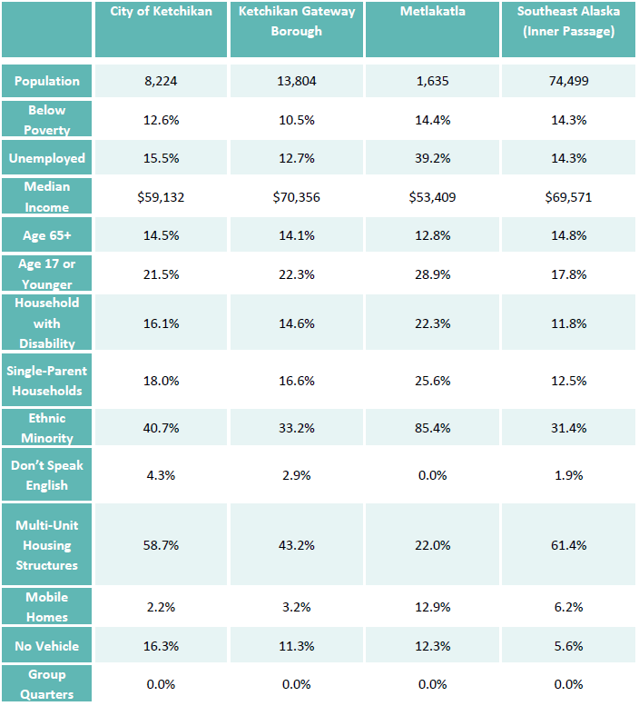
Demographics
Of the approximately 14,000 individuals living in the Ketchikan Gateway Borough, 10.5% live below the poverty line. City of Ketchikan is higher, at 12.6%.
The median income in the City of Ketchikan is lower than the Gateway Borough and Southeast Alaska.
Ketchikan has a higher percentage of youth under the age of 18 than Southeast Alaska.
Ketchikan has a high percent (18%) of single-parent households than Southeast Alaska.

Slide 5
Key Insights - Poverty
Poverty Rates by Race/Ethnicity
Poverty rates are slightly higher in the City of Ketchikan than comparative regions.
27.6% of Alaskan Natives/American Indians in the City of Ketchikan live in poverty
Ethnic minorities experience poverty at a higher rate than white individuals.

Slide 6
Key Insights - Housing
Housing Burden and Occupancy*
Over half of renters in Ketchikan (56.2%) are housing cost burdened. The Southeast Alaska rate of cost burdened renters is 39.6%.
There is very little housing for sale or rent in the Ketchikan Gateway Borough, with just a 1% owner vacancy rate, and a 6.9% rental vacancy rate. However, 16% of overall housing units in the region are vacant, and not for sale or rent - double the Southeast Alaska average. This may present an opportunity to renovate housing units in the region for purchase/rental.
 | The City Ketchikan | Ketchikan Gateway Borough | Metlakatla | Southeast Alaska (Inner Passage)
Owner Occupied | 49.3% | 60.8% | 74.0% | 64.0%
Renter Occupied | 50.7% | 39.2% | 26.0% | 36.0%
Housing Cost Burdened (Owner) | 31.2% | 29.6% | 8.7% | 28.6%
Housing Cost Burdened (Renter) | 56.2% | 53.2% | 28.9% | 39.6%
Vacant Housing Units | 15.5% | 16.0% | 11.3% | 8.4%
Owner Vacancy | 1.3% | 1.0% | 0.0% | 2.2%
Renter Vacancy | 5.8% | 6.9% | 7.9% | 2.9%
*a household is cost burdened when it spends greater than 30% of income on housing
SOURCE: American Community Survey, 2013-2018 5-Year Estimates, ESRI Data 2020
Notes:
Vacancy rate groups consist of vacant units offered for rent and those offered both for rent and sale. SOURCE: https://www.census.gov/housing/hvs/definitions.pdf
A housing unit is vacant if no one is living in it and is not on the market for rent or sale. In addition, a vacant unit may be one which is entirely occupied by persons who have a usual residence elsewhere. New units not yet occupied are classified as vacant housing units if construction has reached a point where all exterior windows and doors are installed, and final usable floors are in place. SOURCE: https://www.census.gov/housing/hvs/definitions.pdf
year.”

Slide 7
Key Insights – Access & Utilization
“More services are needed. We have a good number of providers, but many don't accept Medicaid, or many providers are booked for months and people just end up going to the Emergency Department.”
 | Ketchikan Gateway Borough | Prince of Wales-Hyder Census Area (Metlakatla) | Alaska | United States
Uninsured Adults | 17.5% | 22.8% | 16.3% | 12.5%
Uninsured Children | 10.9% | 13.7% | 8.8% | 5.2%
Uninsured Elderly | 0.6% | 1.3% | 1.2% | 0.8%
Avoidable Hospitalizations | 2,937 | ND | 2,809 | 4,624
Rate of Primary Care Physicians | 100.8 | 77.3 | 91.0 | 76.6
Rate of Mental Health Providers | 273.0 | 124.6 | 433.4 | 202.8
The Ketchikan Gateway Borough has a much higher rate of uninsured adults (17.5%) than the national average (12.5%).
  Black or African American residents average the most uninsured population by race in Ketchikan.
  Native American or Alaska Native persons are the second likeliest to be uninsured, at 22.5%, though there are services in the region aimed directly at helping indigenous populations.
  The Asian community is uninsured at a rate of 11.3% in Ketchikan.
The high rate of mental health providers in the region suggests an understanding that mental health treatment is much needed in the area. However, most do not accept Medicaid/Medicare.
SOURCE: Behavioral Risk Factor Surveillance System (BRFSS) Healthy People 2020. 2016.

Slide 8
Key Insights – Prevention
Preventive Lifestyle Measures
 | Ketchikan Gateway Borough | Prince of Wales-Hyder Census Area (Metlakatla) | Alaska | United States
Adults who are Obese | 38.4% | 39.6% | 31.8% | 29.5%
Percentage of Adults Current Smokers | 22.7% | ND | 20.2% | 18.1%
Percentage of Adults Reporting Binge or Heavy Drinking | 21.6% | ND | 18.7% | 16.9%
Preventive Health Measures
 | Ketchikan Gateway Borough | Prince of Wales-Hyder Census Area (Metlakatla) | Alaska | United States
Mammogram Screening | 24% | ND | 28% | 32%
Pap Test | 74.2% | ND | 77.6% | 78.5%
Sigmoidoscopy or Colonoscopy | 49.0% | ND | 57.8% | 61.3%
Diabetes Management – Hemoglobin A1c Test | 80.9% | 61.5% | 74.6% | 85.7%
SOURCE: Behavioral Risk Factor Surveillance System (BRFSS) Healthy People 2020. 2016.
Rates for preventive tests in the Ketchikan Gateway Borough are lower than state and national rates, which may correlate to cancer being the region’s leading cause of death.
The Ketchikan Gateway Borough has a higher rate of binge drinking, individuals who smoke, and obese adults than comparative regions.
SOURCE: Behavioral Risk Factor Surveillance System (BRFSS). Healthy People 2020, 2016.

Slide 9
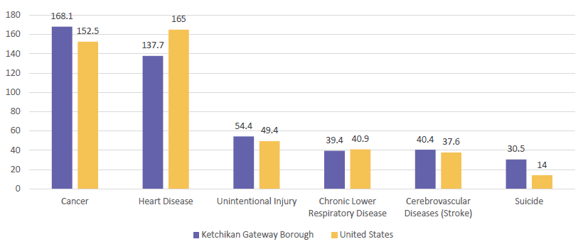
Key Insights - Causes of Death
Suicide rates in Ketchikan are some of the highest rates in the nation. Rates are approximately twice the national average.
The leading cause of death in Ketchikan is cancer – this is unlike the United States and every state in the country.

Slide 10
Key Insights - Alcohol
Premature Death Rates Associated with Substance Abuse, per 100,000 Population
 | Ketchikan Gateway Borough | Prince of Wales-Outer Ketchikan | Alaska
All Causes | 839.6 | 829.9 | 765.9
Alcohol Induced | 24.5 | 36.1 | 19.4
Drug Induced | 12.4 | ND | 14.5
Unintentional Injury | 38.0 | 56.6 | 55.2
Suicide | 30.5 | 30.9 | 21.7
Homicide | ND | ND | 5.2
The Alaska average of alcohol induced deaths (19.4) is more double that of the United States average (7.6).
Ketchikan Gateway Borough has a premature death rate approximately three times the national death rate and 26.3% higher than the state rate.
SOURCE: State of Alaska Epidemiologic Profile on Substance Use, Abuse and Dependency. 2013.

Slide 11
Key Insights - Detox Center
“I have a family member who is living with me who is struggling with heroin. He is technically homeless, and he is afraid. We’ve been wondering if there is a detox center.”
“Substance abuse treatment, especially detox, is very limited in this community and many of the services are available in another community, making post-rehab adjustments even more difficult.”
“This is a HIGH need. Without a detox people who want to begin treatment often don’t due to wait times.”
“A detox center would relieve the pressure on the hospital ER”
The need for a detox center was mentioned in all four focus groups and almost all 16 stakeholder interviews. It ranked as the highest need in the community survey.

Slide 12
Key Insights – Youth & Substances
Binge drinking has reduced by half since 2013.
Around 1 in 10 Ketchikan students reported binge drinking in 2019.
Prescription drug use without a Dr’s approval has decreased since 2013.
1 in 10 Ketchikan students report abusing prescription medication
Percentage of Students who Binge Drink
Percentage of Students who Abuse Prescriptions
SOURCE: Alaska Youth Risk Behavior Survey. 2013-2019.

Slide 13
Key Insights – Youth & Substances
Heroin Use (grade 9-12)
Methamphetamine Use (grade 9-12)
Heroin use is high among Alaska and Ketchikan students, 2.4% and 1.9% respectively.
The use of heroin peaked in 2013 and spiked again in 2017.
Approximately 2% of Ketchikan students reported using methamphetamine in 2019, reflecting 16 Ketchikan high schoolers who used meth in the past month.
The rates of methamphetamine by Alaska and Ketchikan students are significantly higher than the national average (0.3%; 2016)

Slide 14
Youth Drug Use Prevention Education
“Youth start experimenting with alcohol around 14 to 17 years. Then they transition to meth, heroin, and pills. Parents are addicted and so are kids.”
“The school district can embrace more consistent education, so every grade gets reinforcing messages each year.”
“We have this in schools, having a community-based program could be really successful.”
“I’d like NEW content. Taught to kids in a new way.”
“The school system’s struggle to acknowledge there is a problem among the youth with drinking and other substances - kids are dealing with issues at home, and a lot of them don’t know how to ask for help.”

Slide 15



Key Insights – Youth Mental Health
Percentage of Students who Attempted Suicide
Percentage of Students who Seriously Considered Suicide
21.8%
SOURCE: Alaska Youth Risk Behavior Survey. 2013-2019
The rate of high schoolers in Ketchikan reportedly attempting suicides has risen every year since 2013
One in every nine Ketchikan high schoolers (11.9%) reported attempting suicide. One in every five Alaska high schoolers (19.7%) reported attempting suicide. These numbers are higher than the United States average (7.0%).
SOURCE: Alaska Youth Risk Behavior Survey. 2013-2019.
The number of students who have seriously considered suicide in Alaska has risen around 10% since 2013, whereas rates in Ketchikan have fluctuated between 26% and 21%.

Slide 16
Top Overall Needs Community Survey Results
* ranked by % that stated “much more focus needed”
Substance Use treatment and rehabilitation, such as detox
Affordable Housing
Affordable, quality childcare
Case workers/navigators for people with mental health/substance use challenges
Counseling services for mental health challenges for adolescents/children
Substance use education, prevention, early intervention services or adolescents/children
Counseling services for mental health issues for adults
Healthcare services for people experiencing homelessness
Urgent care services
Social services (other than healthcare) for people experiencing homelessness

Slide 17
Community Needs Top Themes
Access to Affordable Housing: the limited supply of affordable housing options and limited assistance provision is not meeting the current need.
  “Housing is a major problem - is there a middle class here? You can either afford a house or apartment here or you're out of luck.”
  “Housing is a tremendous barrier in our town and can lead to unsafe living conditions for families”
Homelessness: There are unique needs for the homeless population.
  “I would like to see a plan - not just "shelters" as band aid solutions. Services that work together”
Transportation: Options are limited and can be difficult to access.
  “Transportation to get to doctors’ appointments and other places can be hard. I have a friend who is struggling with mental health and substance use issues and complains she doesn’t have money to get to a dentist appointment.”

Slide 18
Community Needs Top Themes
Behavioral Health Services: There is a continuing, growing need for services designed to address behavioral health and substance use issues.
  “A detox center would relieve the pressure on the hospital ER”
  “Getting people seen quicker so it's not just a crisis response”
Community Health Services: Long wait times and geographical challenges make accessing current services difficult.
  “Urgent care center would be beneficial for many and free up our Emergency Dept”
  “Care coordination is challenging for Ketchikan especially for those who seek care outside of the community (in other parts of AK or in lower 48)”

Slide 19
Community Needs Top Themes
Covid-19 Impact on Employment: Lack of Tourism is negatively impacting current employment opportunities, which will likely lead to long term impacts within various social determinants of health.
“Our current economy is very narrow. Youth have limited opportunities to gain experience and opportunities in sectors outside tourism, fishing, construction, sales.”
Education & Youth Services: Low priority of education and thus a low graduation rate. A need was identified to increase activities and opportunities for youth.
“I think a lot of youth have nowhere to go, nothing to do if they are not in sports.”
“Affordability or activities with transportation options to those activities for underprivileged youth.”
“Transportation to get to doctors’ appointments and other places can be hard. I have a friend who is struggling with mental health and substance use issues and complains she doesn’t have money to get to a dentist appointment.”

Slide 20
Access Audit
Access audit calls were made to 7 behavioral health organizations to identify new patient process, wait times, awareness of other services, and customer service.
Key findings:
Average wait time was about two weeks for new patient appointments, but often longer for psychiatry services.
Most calls went to voicemail with no returned call.
In conversation, people freely referred callers to other providers as needed.

Slide 21
KWC Prioritization
Primary Priorities
Secondary Priorities
Need | Role | Initiative
Establishing caseworkers or "navigators" for people with behavioral health service needs | Lead | Ketchikan123
Increasing suicide prevention awareness campaigns and activities | Lead & partner | Behavioral Health Task Force campaigns
Increasing access to drug and other substance abuse education, prevention, and early intervention services for adolescents / children | Lead & partner | PIERS education campaigns
Increasing access to drug and other substance abuse education, prevention, and early intervention services for adults | Lead & partner | PIERS education campaigns
Increasing recreational activities for youth | Lead & Partner | Ketchikan Youth Alliance
Need | Role | Task Force
Establishing a detox facility in the community | Advocate | PIERS
Expanding drug and other substance abuse treatment and rehabilitation programs | Advocate | PIERS
Increasing access to counseling services for mental health issues such as depression, anxiety, and others for adults | Partner | Behavioral Health
Improving emergency mental health services, such as a crisis intervention | Advocate | Behavioral Health
Expanding access to sources for affordable, nutritious food | Lead & Partner | Building a Healthy Community

Slide 22
Questions

Slide 23

Romanda Simpson romanda@ktnkwc.org
907-225-9355 ext 6
Thank You
For full CHNA report go to www.ktnkwc.org

